Slide 1
PRPA
Prairie Region
of
Photographic Arts

Slide 2
PRPA
Prairie Region
of
Photographic Arts

Slide 3
PRPA …
is an association
of amateur photographers
and camera clubs
in the Prairie Provinces

Slide 4
Mission Statement
“Prairie photographers
sharing
photographic experiences”

Slide 5
History of PRPA
Started in 1960 as Color Photographic Association of Canada (CPAC)
Became PRPA in 1968 as a prairie regional photography association, the same year that NAPA (now CAPA) formed as a national photography organization

Slide 6
PRPA Memberships
There are two membership classes in PRPA:
Individual Membership
Club Membership

Slide 7
Individual Membership
any amateur photographer
annual membership fee $30
participate in all competitions
participate in Print Circuits
receive Prairie Focus newsletter in either digital or print format
vote at Annual General Meeting
eligible to sit on Board of Directors

Slide 8
Club Membership
any photography club in AB, SK, MB
annual membership fee $1 per member
club may enter the two club competitions
members may enter the Hand of Man and Artistic Expressions digital competitions
all club members receive Prairie Focus newsletter in digital format
club may appoint Club Rep to PRPA Board

Slide 9
Print Circuit
critique prints of circuit members
have your prints critiqued
ribbons for First, Second, Third
two circuit rounds per year
usually 3 or 4 circuits, with 5 or 6 members each

Slide 10
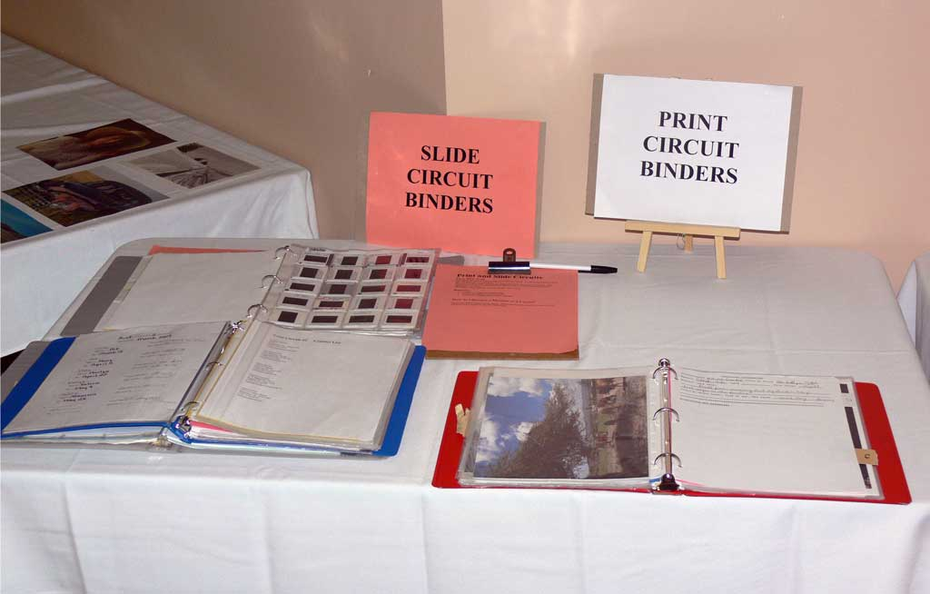
Slide & Print Circuit Binders, 2009

Slide 11
Prairie Focus
Quarterly newsletter
PRPA news and events
winning images of last year’s competitions
Member Club reports
Circuit reports, winning images
meeting reports

Slide 12
Prairie Focus Newsletter Summer 2023

Slide 13
Website prpa.photography
PRPA news, services and events
competition details and entry forms
online membership form
upcoming Outing information
winning images of past competitions
past & current Prairie Focus newsletters

Slide 14
PRPA website

Slide 15
Competitions
no entry fee
ribbons & certificates awarded
trophies for the two club competitions
member clubs take turns judging
6 print competitions
6 digital image competitions
2 digital slideshow competitions

Slide 16
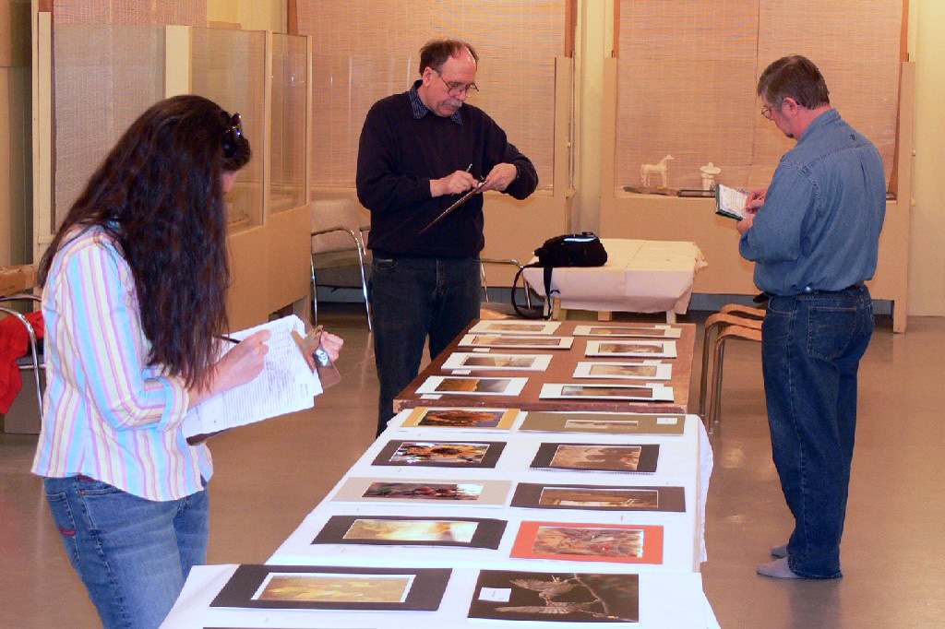
Rosetown Photography Club members judging 2008 Attanyi

Slide 17
Club Competitions
Everest Digital Image Club Competition
20 images per club
Gerry Fish Print Club Competition
10 prints per club
for these two competitions awards are also given for:
Best Landscape
Best Portrait
Best Open
Best Nature
Best Candid Child
Best of Show

Slide 18
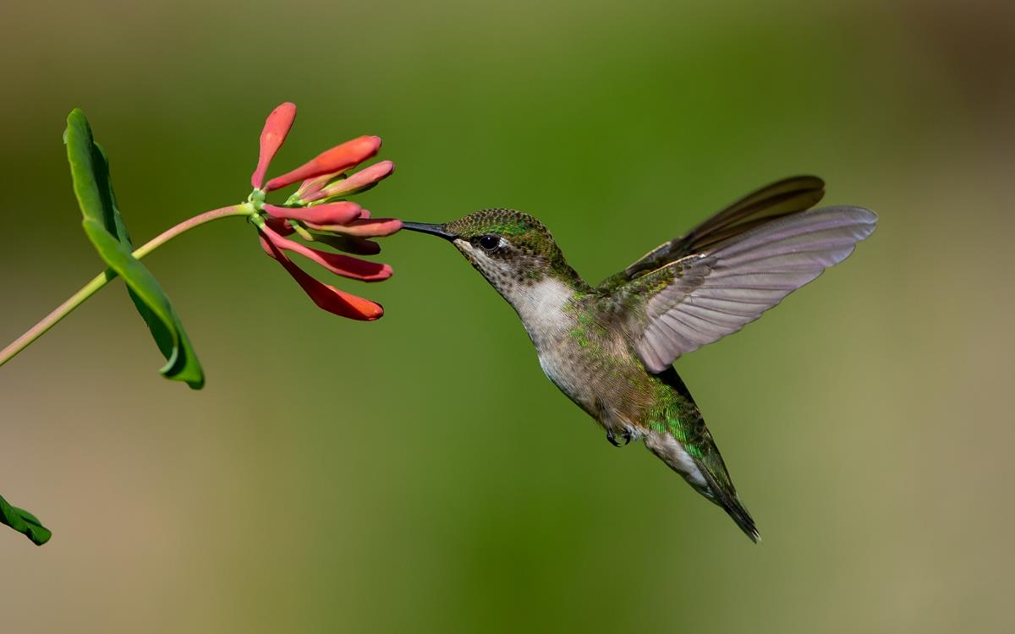
Best Open & Best of Show
Everest Digital Image Club Competition, 2018
Summer Hummer, Bob Schultz, Moose Jaw Camera Club

Slide 19
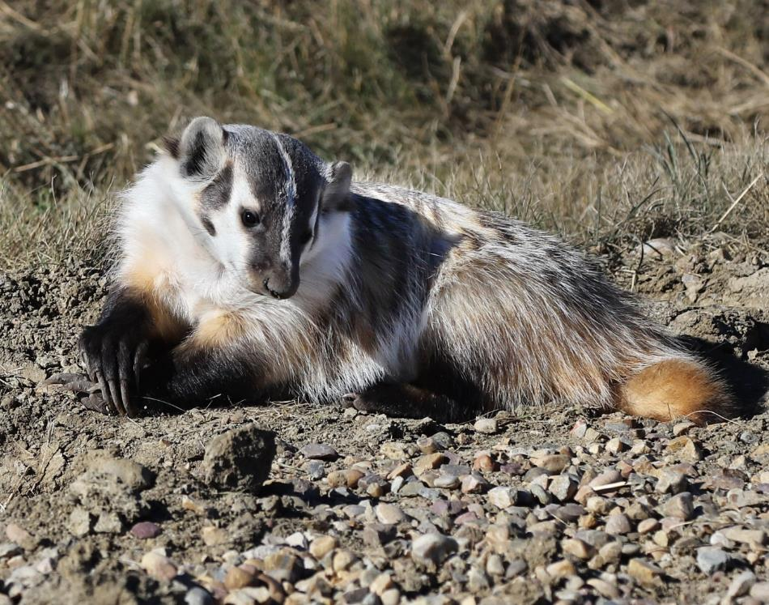
Best Nature & Best of Show,
Gerry Fish Print Club Competition, 2018
Badger, Theresa Busse, Image West P. A.

Slide 20
Digital Image Competitions
Fall Digital Image – open subject
Spring Digital Image – open subject
Russell – pair of opposites to a given theme e.g. Pleasant / Unpleasant
Gail Christensen Artistic Expressions – open to all members of Member Clubs as well as Individual Members
Hand of Man – open to all members of Member Clubs as well as Individual Members

Slide 21
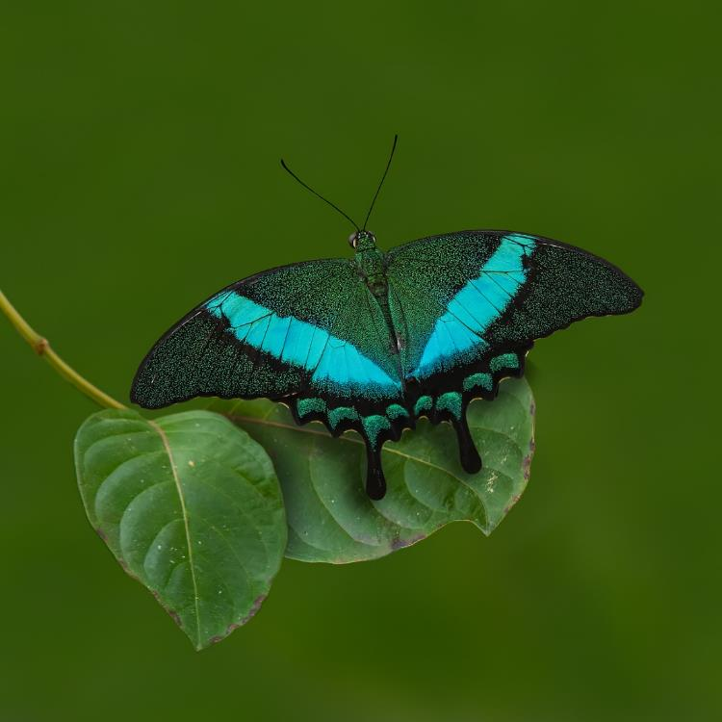
First, Fall Digital Competition, 2019
Tropical Swallowtail, Don Mathieson, Regina Photo Club

Slide 22
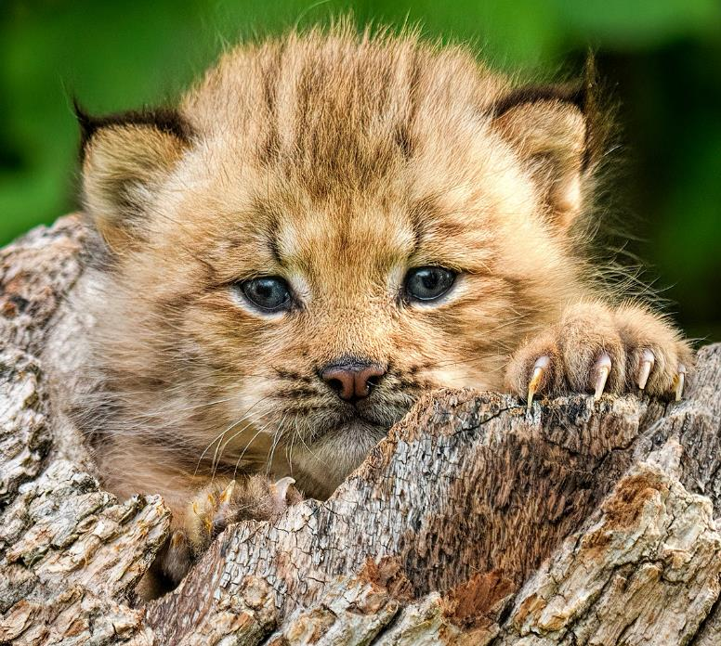
First, Spring Digital Competition, 2020
One Cute Kitten, Marlene Andrew, Image West P. A.

Slide 23
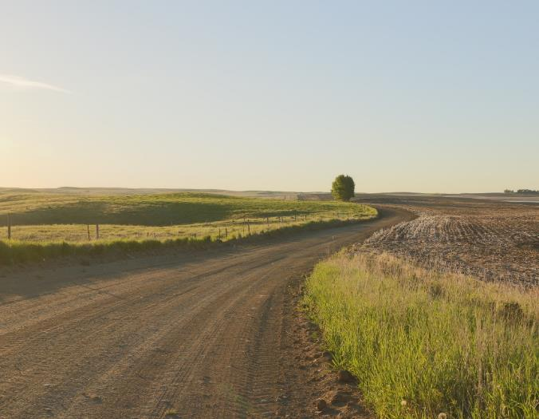
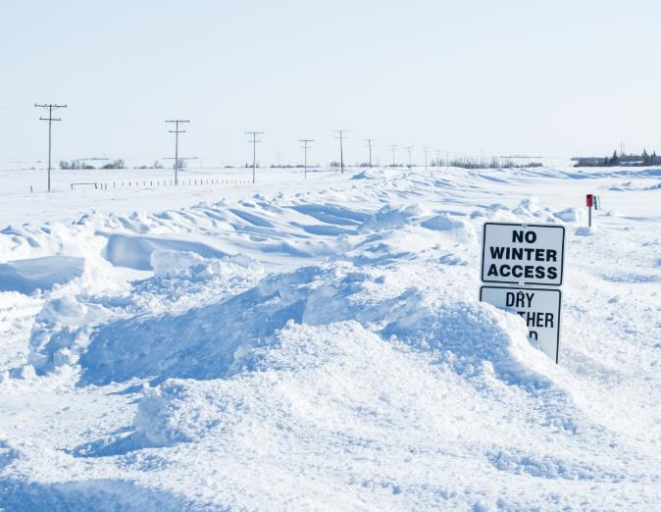
First, 2018 Russell Digital Image Competition Theme: Open / Closed Rusty Morris, Rosetown Photography Club
The Open Road
Closed for The Winter

Slide 24
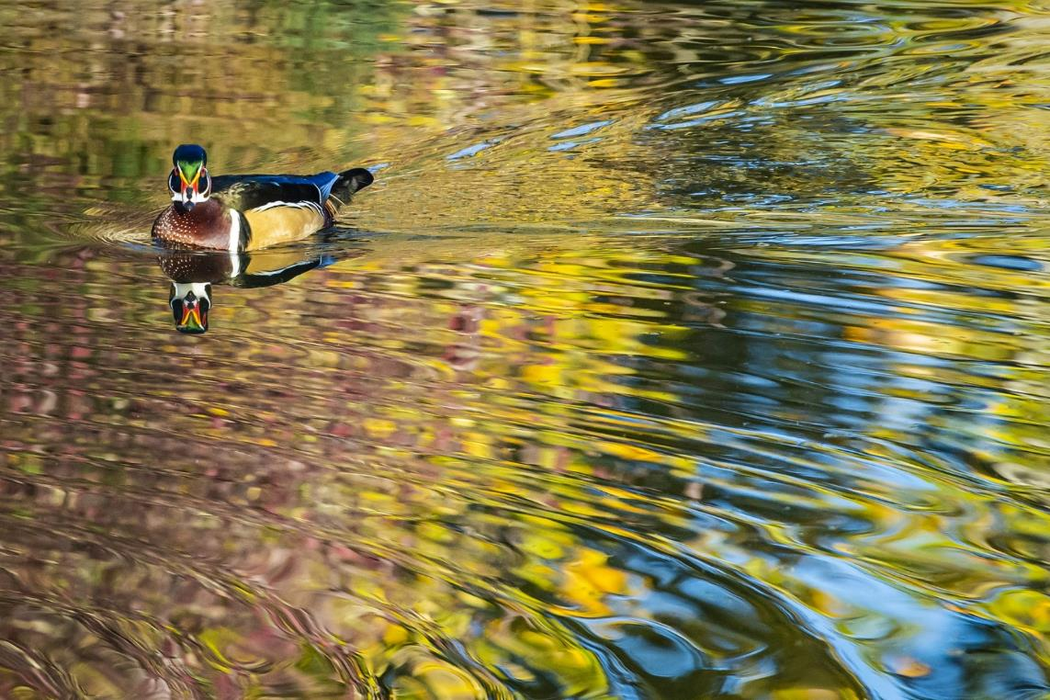
Second, Gail Christensen Artistic Expressions Competition, 2022
Splash of Colors
Khang Nguyen, Foothills Camera Club

Slide 25
First, Hand of Man Digital Image Competition, 2018
Lonely Road to Monument Valley
Richard Collens, Foothills Camera Club

Slide 26
Print Competitions
Attanyi Salon – open theme
Human Portraiture
Sports in Action
Curtiss Lund Altered Reality
Print Portfolio – five 4 x 6 prints on themes: Landscape, Nature, Portrait, Candid Child, Open

Slide 27
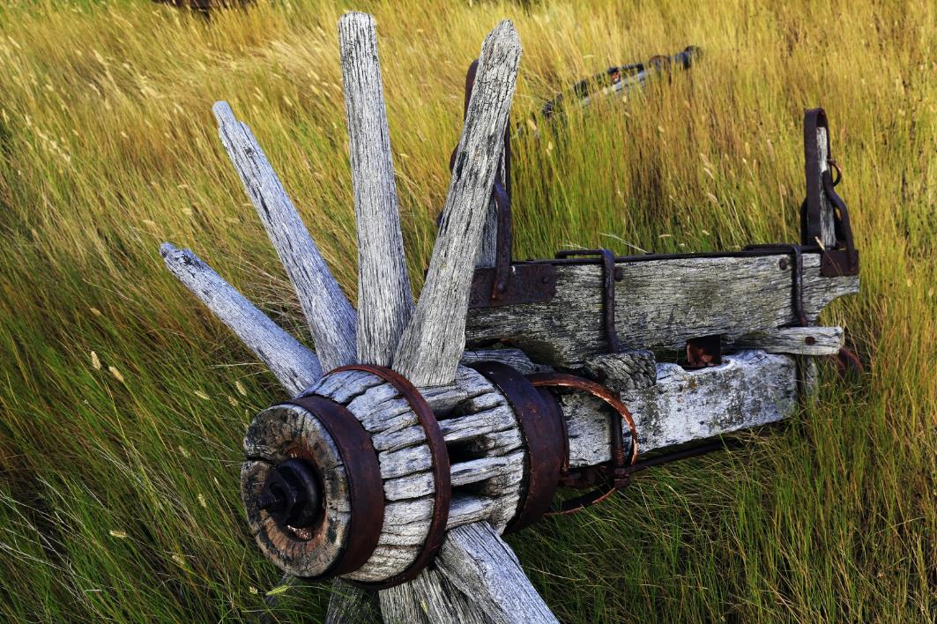
First, Attanyi Salon Print Competition, 2019
Broken Spokes, Larry Easton, Regina Photo Club

Slide 28
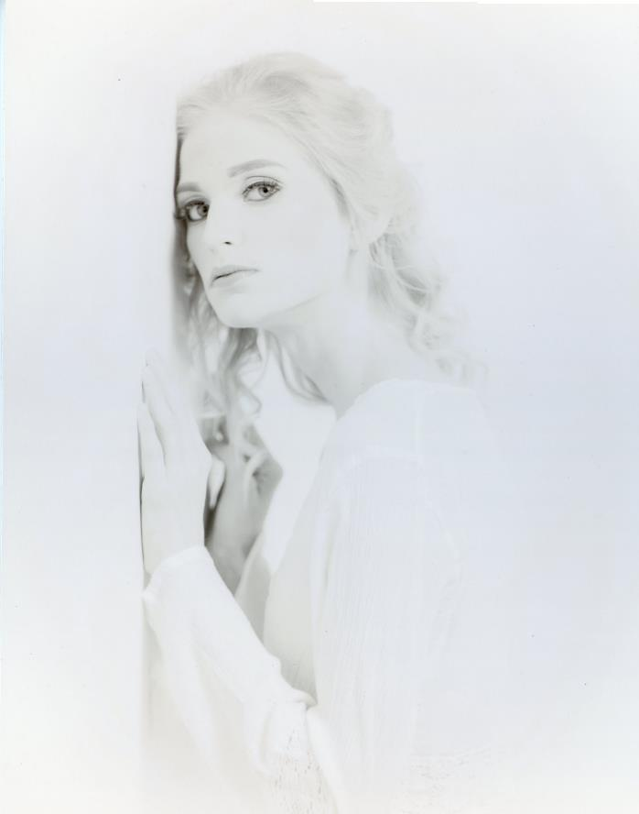
First, Human Portraiture Print Competition, 2019
Faded Dreams,
David Bellerive,
Regina Photo Club

Slide 29
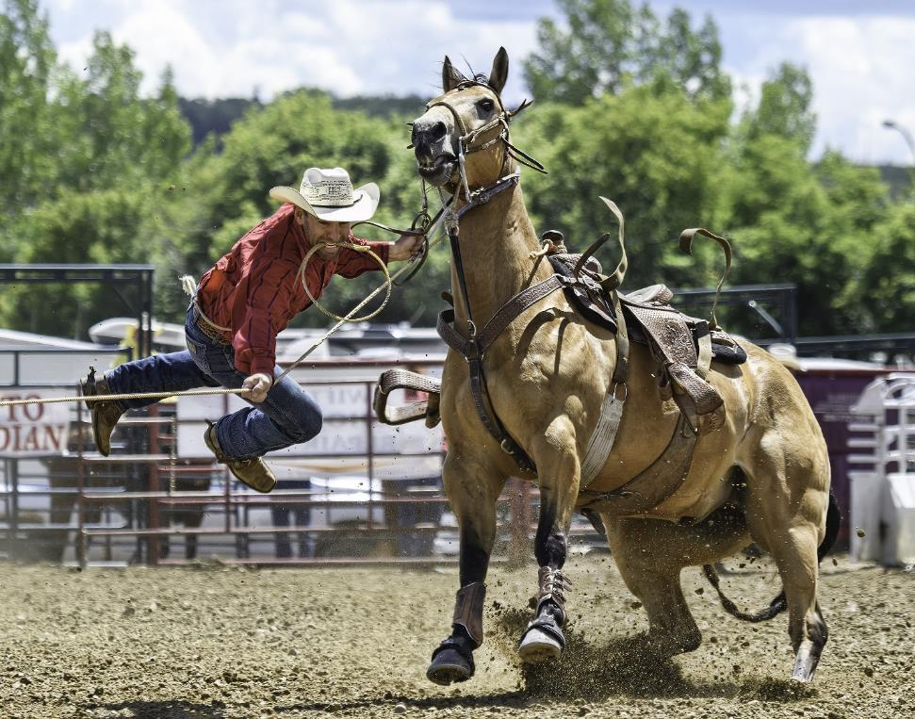
First, Sports in Action Print Competition, 2020
The Dismount, Marlene Andrew, Image West P. A.

Slide 30
First, Curtiss Lund Altered Reality Print Competition, 2019
Whooper the Crane at Waikiki
Gail Christensen, Image West Photographic Association

Slide 31
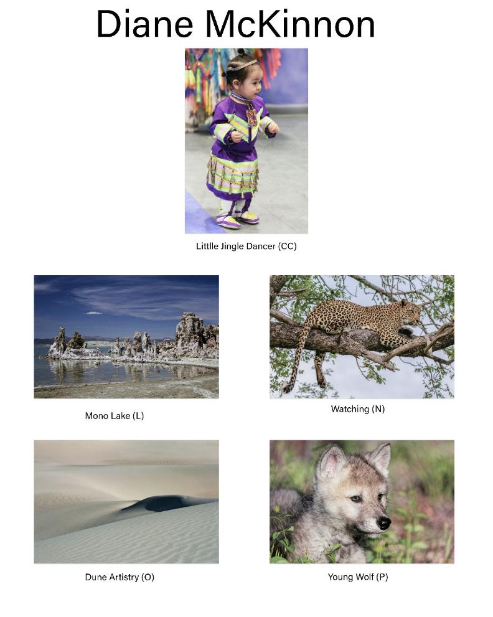
First, Portfolio Print Competition, 2019
Diane McKinnon,
Image West P. A.

Slide 32
Slideshow Competitions
Single Song Digital Slideshow
Fall competition
1 song, 5 minute max.
photos to match lyrics
Showmanship Competition
held at the Outing
8 minute max.
individual or group

Slide 33
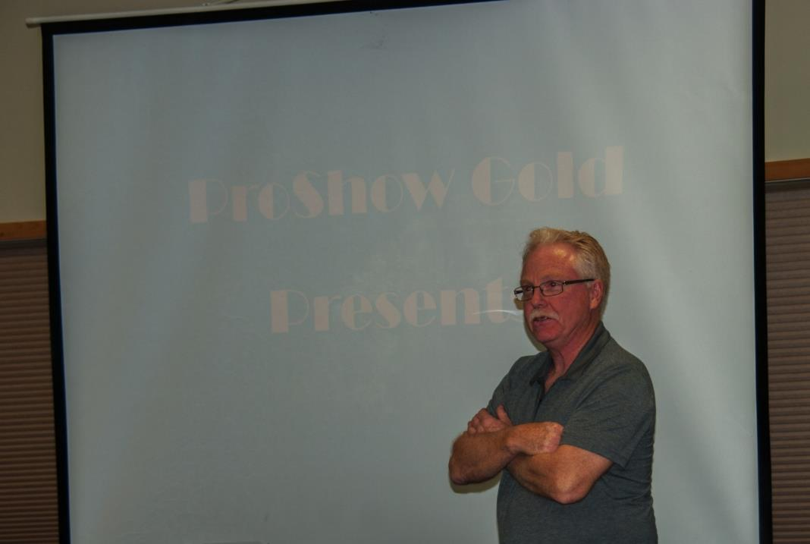
Rusty Morris, Rosetown Photography Club introducing his slideshow entry Showmanship Competition, 2015 Outing

Slide 34
Annual Outing
held on a weekend in June
AGM and guest speaker Friday evening
photographic tours to scenic locations
Awards Presentation & entries slideshow
Showmanship Competition
Outing Competition for participants
print competition entries on display
Fun & Fellowship!!

Slide 35
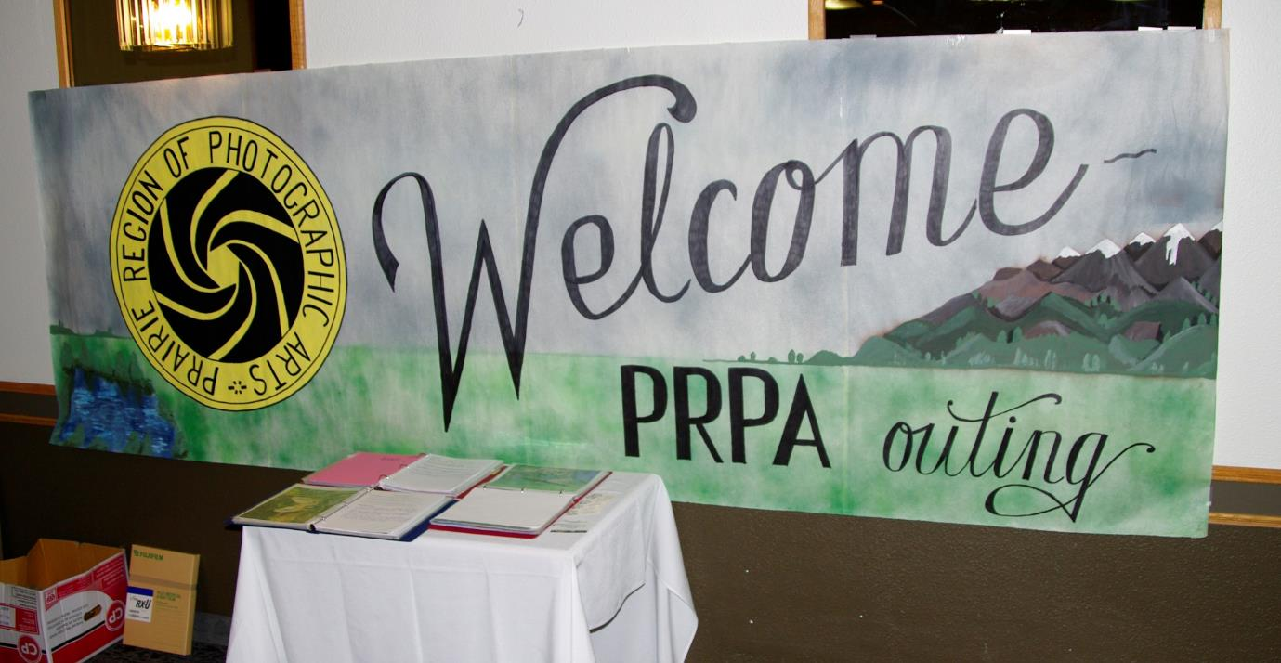
The Outing Banner painted 1999 by Gleneath Camera Club

Slide 36
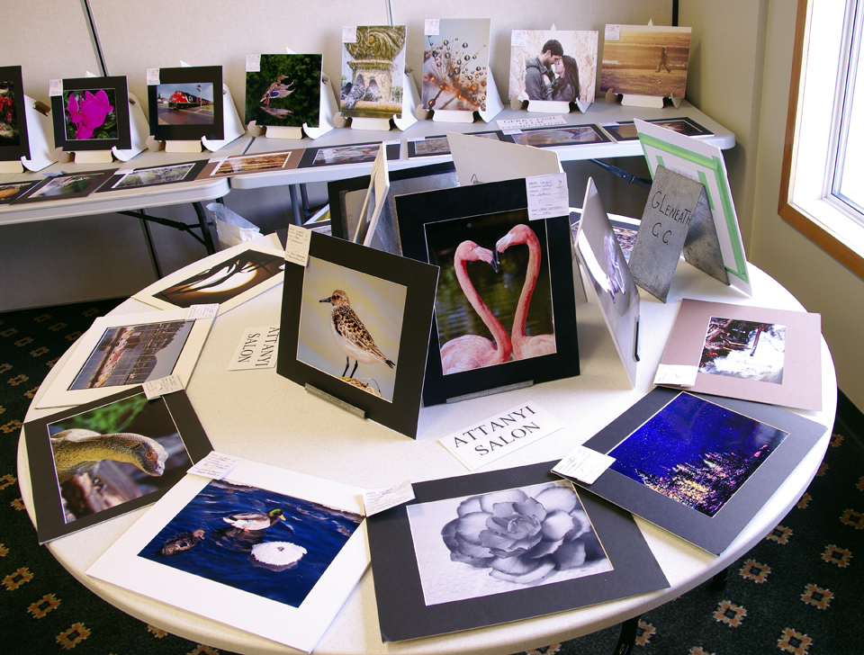
Print Entry Displays, Candle Lake Outing, 2015

Slide 37
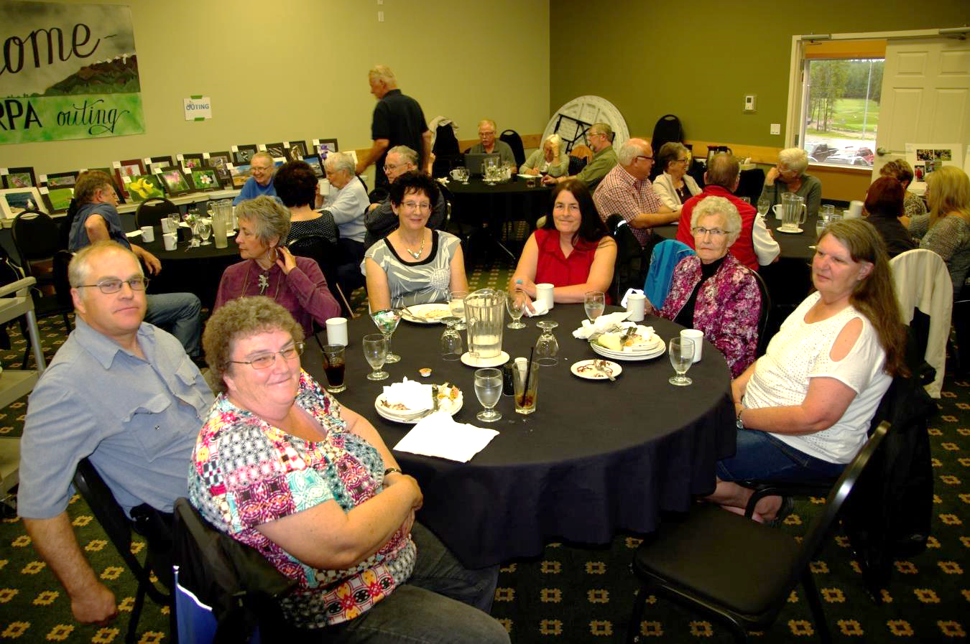
Banquet, Candle Lake Outing, 2015

Slide 38
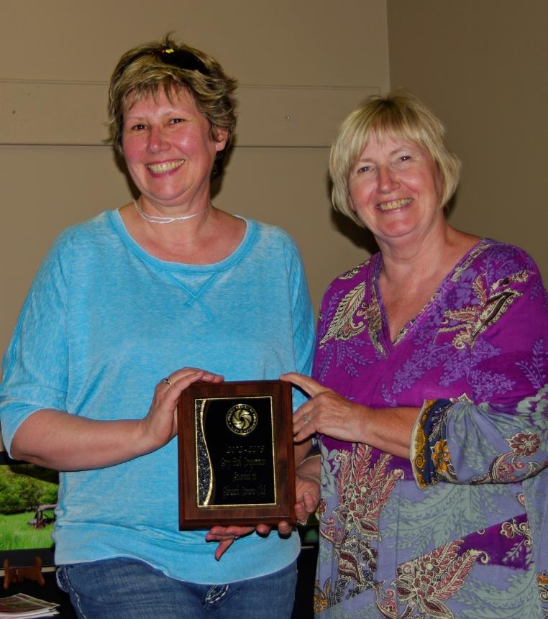
Gerry Fish trophy
presented to
Gleneath Camera Club
Manitou Springs Outing, 2013

Slide 39
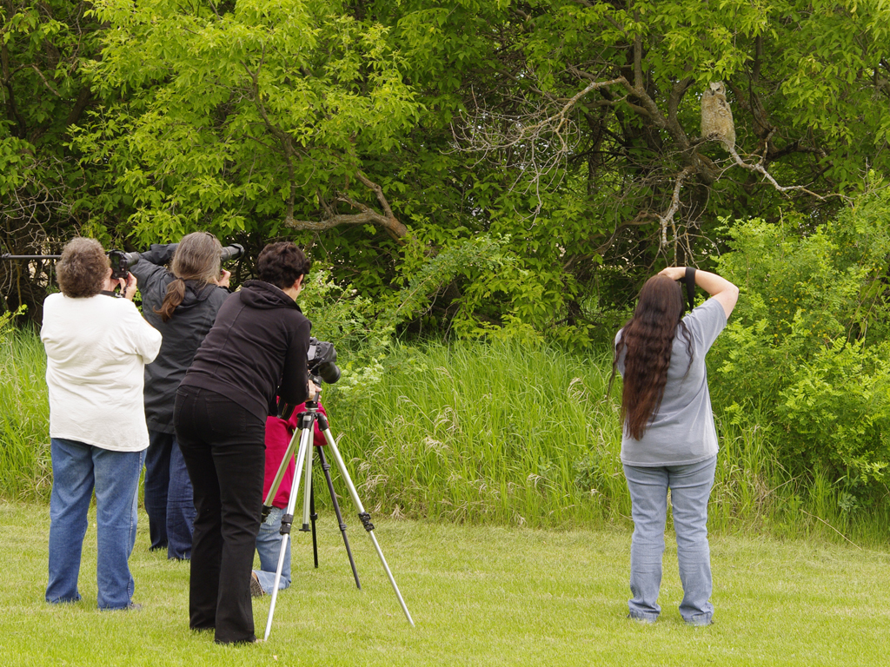
2012 Outing – Arlington Beach

Slide 40
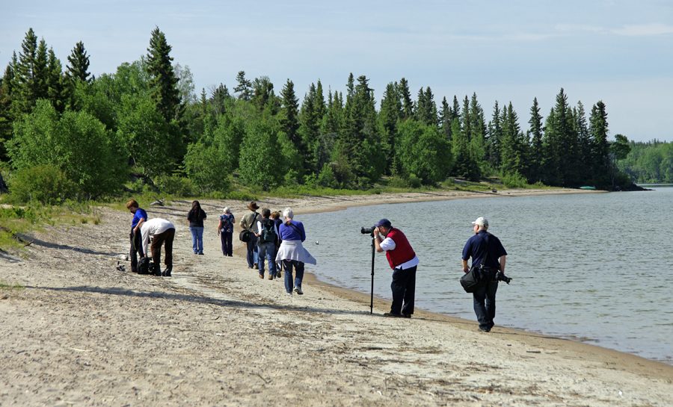
2015 Outing – Candle Lake

Slide 41
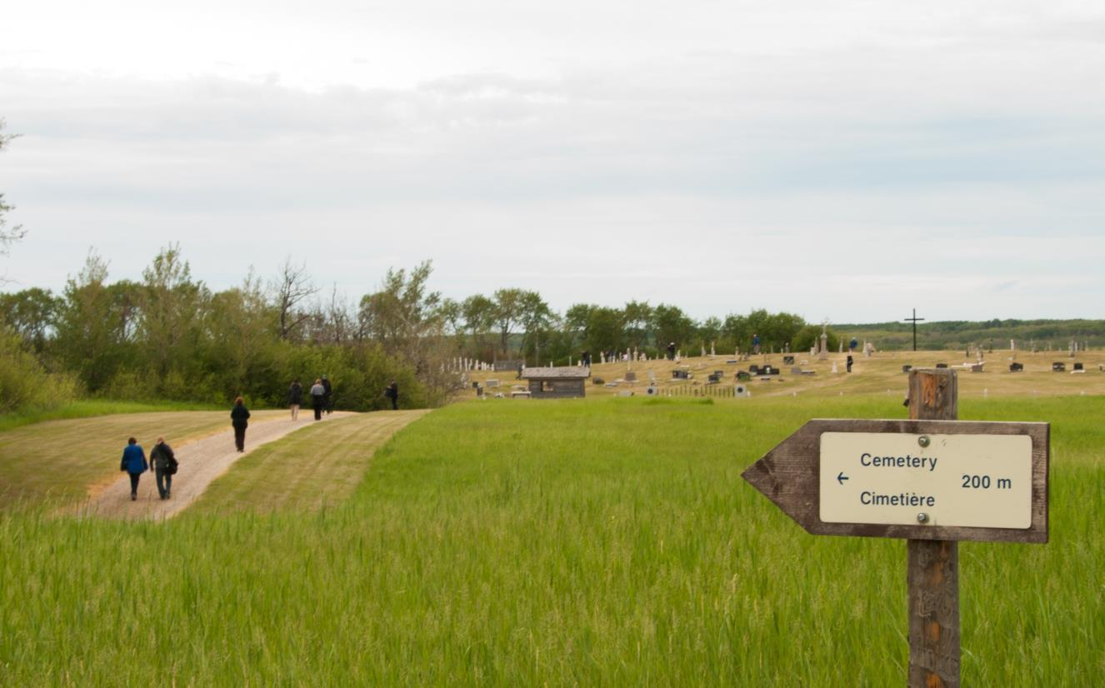
2016 Outing – Batoche / Wanuskewin

Slide 42
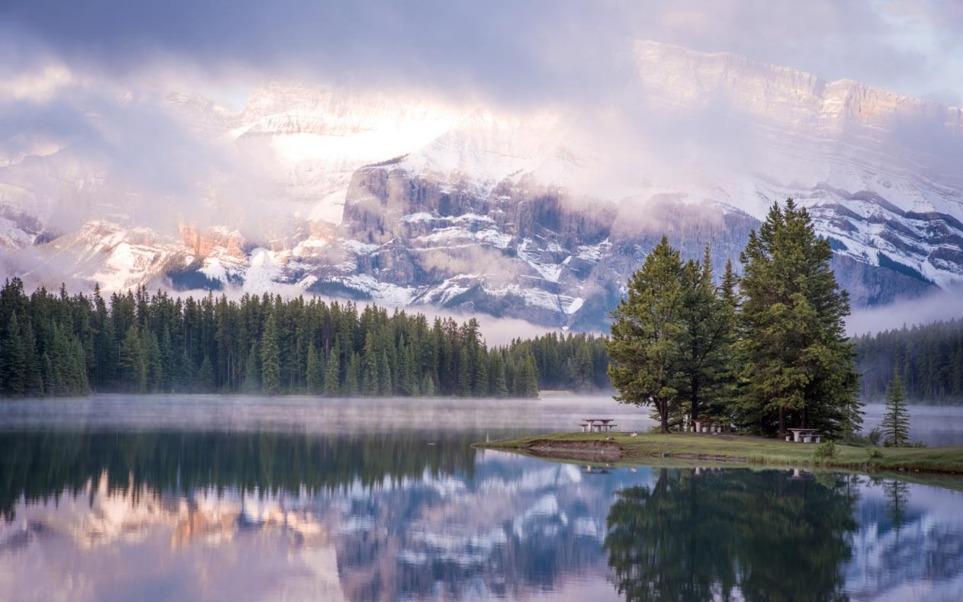
2017 Outing – Canmore
“Sunrise Mist on Two-Jack Lake” by Kelly Thorson

Slide 43
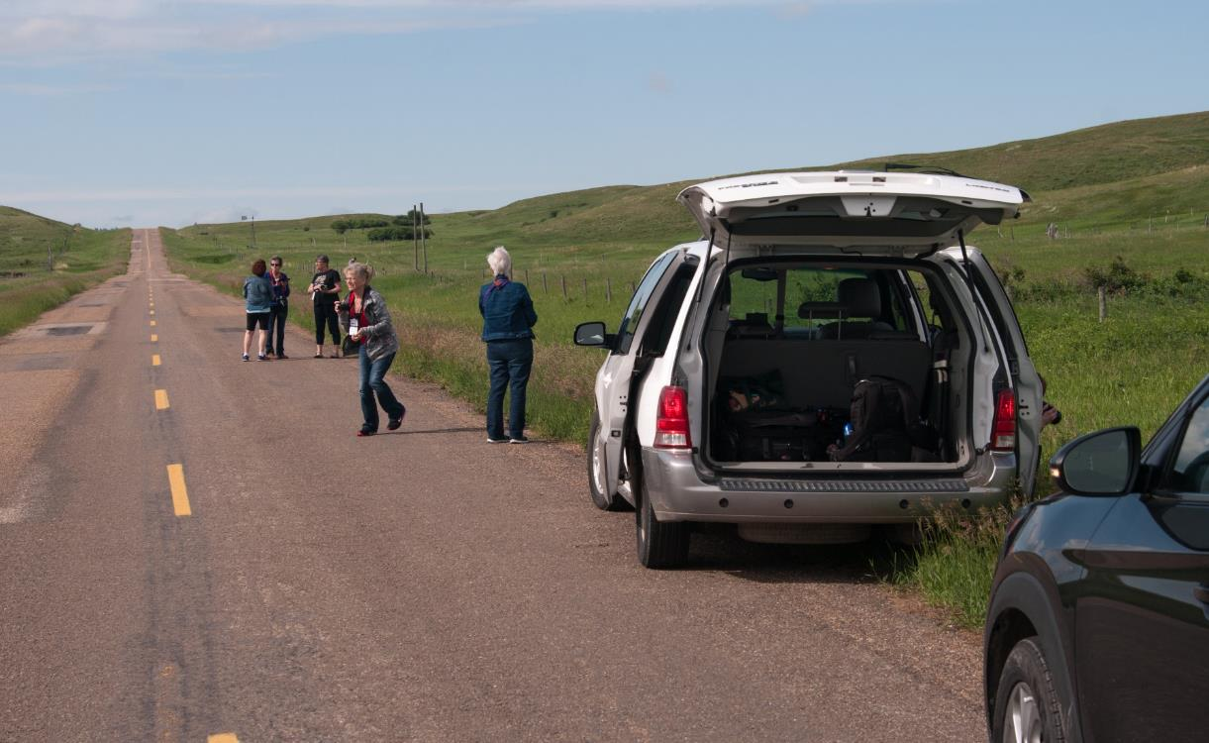
2018 Outing – Maple Creek
Roadside stop en route to Cypress Hills

Slide 44
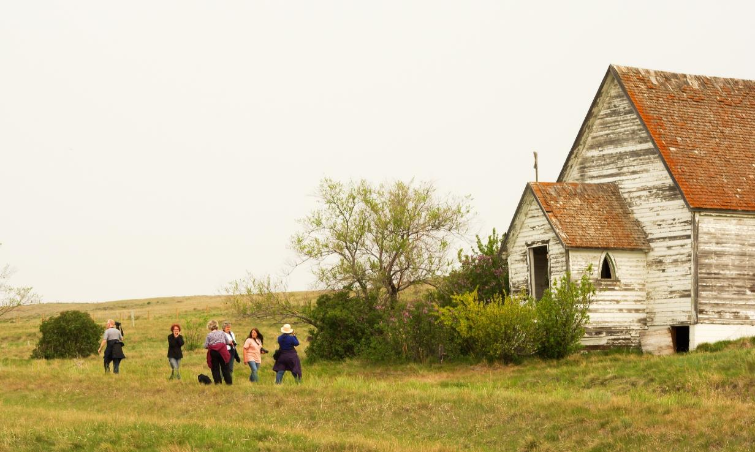
2019 Outing – Swift Current
Neidpath Church

Slide 45
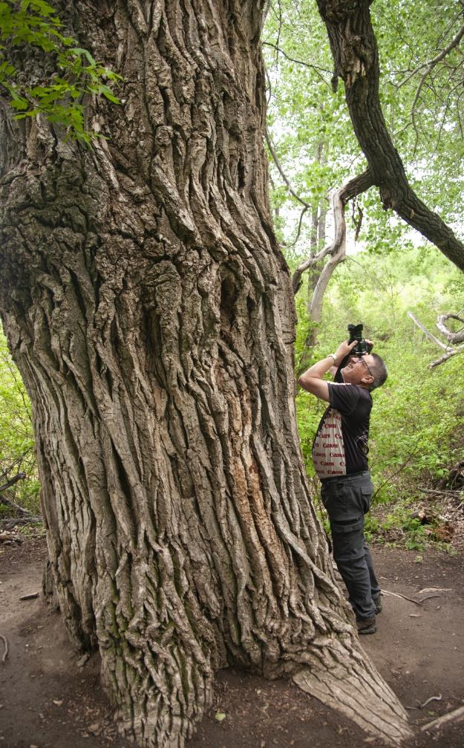
2022 Outing – Hepburn
The Popoff Tree

Slide 46
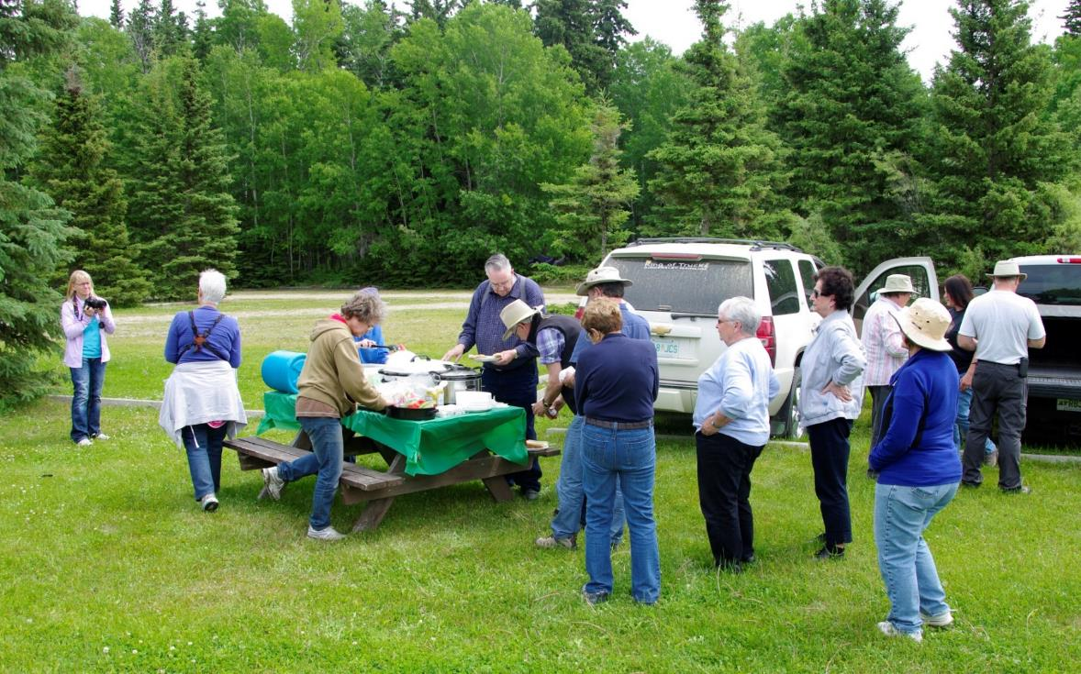
Picnic in the Park, Candle Lake Outing, 2015 Join PRPA! Join the fun!

Slide 47
PRPA
Prairie Region
of
Photographic Arts

